Slide 1
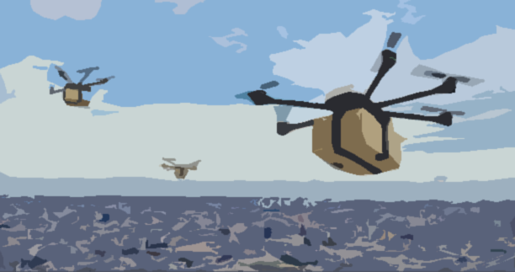
OPTIMIZATION OF CUSTOMER LOCATION CLUSTERING AND DRONE BASED ROUTING FOR LAST MILE DELIVERY
FINAL PRESENTATION
MOHD FAISAL AFTAB
SAIREDDY SHREYAS
AMGOTH THARUN
BANOTHU GANESH NAIK
Guided by
Dr. Ratna Kumar K (MED)
Dr. Sudarshan C (CSED)

Slide 2
CONTENTS
Introduction
Objectives
Systematic Literature Review
Problem statement
Clustering Algorithm
Mathematical modelling
Information gathering
NITC Simulation
Conclusion
Future Scope

Slide 3
INTRODUCTION
As the world is becoming more and more global the significant of a good and well managed supply chain is very important for better working of the businesses around the world.
With the emergence of E-commerce and Q-commerce, the need for fast and cost effective supply chain is increasing rapidly.
With the advancement of technology there have been an unprecedent change in the supply chain but the last mile delivery is still done by traditional way with only truck and vans.
This traditional process of delivering goods is not efficient in the long-run due to increasing traffic congestion and growing customer expectations (Tuerk, 2019; Fehr and Peers, 2019)
The last mile delivery is the phase of supply chain which costs a major chunk. A report by Capgemini highlights that the last mile delivery accounts for 53% of the entire shipping costs and 41% of the overall supply chain costs.

Slide 4
CONTINUED..
Over 70% of the consumers across the globe are price sensitive and are reluctant to pay for faster delivery (Joerss et al., 2016). Yet, a majority expects reliable as well as quick delivery of goods. As a result, companies are competing to achieve cost-efficient and faster last-mile delivery operations.
Owing to its relatively low operating cost and congestion-free aerial route, drones are a viable and attractive alternative for such operations (Raj and Sah, 2019). Besides, drones provide an environmentally friendly mode of delivery if low carbon electricity sources are used to charge batteries (Stolaroff et al., 2018; Kirschstein, 2020).
Due to rapid growth in Business-to-Consumer (B2C) transactions, where packages are smaller, drones are viable to deliver most customer orders (Guglielmo, 2013).
Recently, the application of drones in delivery logistics has emerged prominently, especially after the initiatives of big corporations such as Amazon (2016), Google (X-Company, 2016), and DHL (2014).
In our project we want to find a better solution for routing of the drone so that the last mile delivery can be done in quick, efficient and cost effective way.

Slide 5
OBJECTIVES
Develop an algorithm that optimizes drone route to minimize energy consumption and cost optimization.
Evaluation of the purposed model using the collected data against pre-existing algorithm.
Conducting a campus-specific routing simulation for a Higher Institution to refine and validate proposed solutions

Slide 6
SYSTEMATIC LITERATURE REVIEW
Conducted a systematic literature review (SLR) on hybrid truck and drone route optimization.
Examined literature from 2019 to 2023 to capture recent advancements.
Focused on various factors such as drone flying time, load capacity, and battery efficiency.
Employed a rigorous and predefined process to ensure methodological integrity.
Identified and synthesized complex variations within the problem, including the roles and numbers of drones and trucks.
Selected keywords to guide the search process effectively.
Recognized the significance of the topic in enhancing last-mile delivery systems

Slide 7
FILTERING JOURNALS
Scopus search using keywords (370 papers)
Filter papers based on titles (112 papers)
Filter papers based on abstracts (27 papers)
Filter papers based on content (11 papers)
Using Bibiliometrix software, we got the excel file containing all the relevant papers.
We followed the procedure mentioned in the right to get the most relevant research papers for our project topic.
Below are the literature review of 6 of the papers we have read and reviewed.

Slide 8
LITERATURE REVIEW
Author | Contribution | Scope of future research
Blanco et al, Jan 2022 | Improving upon the Truck-Drone Traveling Salesman Problem (TDTL), simplifying the Multiple Flying Sidekick Traveling Salesman Problem (mFSTSP) Introducing an agent-based approach on a grid representation. Compare their model's performance against existing instances, achieving favourable results in larger cases. | Explore parallelization for enhanced computational speed, leveraging effective agent communication. Expand the algorithm's scope to address larger instances and accommodate multiple ground vehicles. Incorporate real-life constraints like vehicle variations, payload differences, and battery depletion models using parallel programming.
Javadi et al, Aug 2021 | Evaluate customer-centric delivery models (FTRPD, STRPD, and MTRPD) and their performance on various problem instances. Investigate the impact of key parameters like the number of UAVs, UAVs to truck speed ratio, and flight time limit on model effectiveness. Determine the model that outperforms others and assess the reduction in customer waiting times compared to a truck-only approach. | Increase synchronization in FTRPD by allowing UAVs to launch from the moving truck for potential performance improvements. Analyze and quantify the performance gain achieved by the enhanced synchronization level in the model. Explore the inclusion of additional real-world factors in these models, such as customer time windows, no-fly zones, and regulatory constraints, for more comprehensive and practical applications.

Slide 9
Author | Contribution | Scope of future research
Mulumba et al, Sep 2023 | Introduces a Mixed Integer Programming formulation, providing new optimal solutions and improved bounds for Fixed-Start Traveling Salesman Problem(FSTSP). Presents the Hybrid Tabu General Variable Neighborhood Search (HTGVNS) algorithm for larger instances, demonstrating its effectiveness through numerical analysis. Highlights the efficiency of a truck-drone delivery system, particularly with faster drones. | Allowance for the formulation to consider multiple UAVs per truck. Determination of the optimal number of UAVs to deploy per truck. Consider the dynamic case where requests for pickup and delivery are made in real-time.
Salamaa et al March 2020 | The primary objective of paper is to optimize the total cost of delivery and total time of completion of delivery It also try to provide an algorithm which can find the optimize solution in minimum time. Also try to know the optimal number of drone in a truck for minimum cost of delivery | The main gap in the paper is that it only consider one truck- multi drone instead of multi-truck and drone. The future scope is to improve the heuristic algorithm for getting fast solution and also finding solution for multi-truck multi drone problem.

Slide 10
Author | Contribution | Scope of future research
Nguyena et al, July 2021 | Minimize total operational cost in the PDSTSP. Add constraints for parcel weight distribution among trucks and total vehicle working time. Study the PDSVRP, a derivative of the Vehicle Routing Problem, considering multiple trucks and drones. | Explore advanced algorithms and heuristics for improved problem-solving. Incorporate real-world constraints and dynamic adaptations into the model. Investigate multi-objective optimization, sustainability, and emerging technology integration for enhanced solutions.
Freitas et al, Sep 2023 | The paper introduces DAPDP, extends MILP formulation, and proposes an efficient solution method. Performance analysis demonstrates cost savings from drones and trucks collaboration, including fuel and labour cost reductions. | Future research can explore extensions of DAPDP, such as allowing multiple UAVs per truck and optimizing their deployment. Investigating real-time dynamic scenarios for pickup and delivery requests presents another promising avenue for study

Slide 11
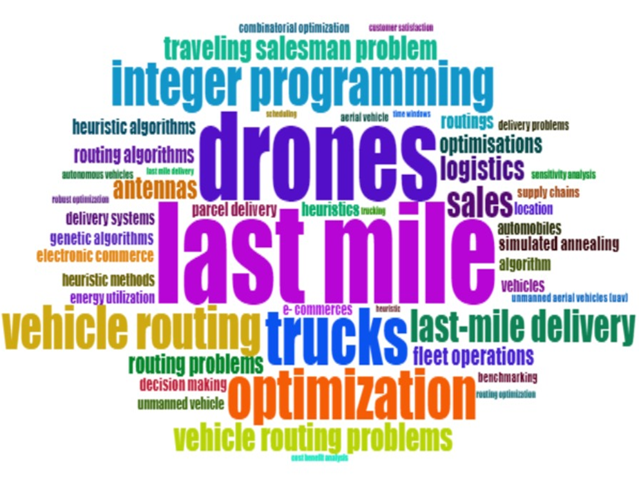
VISUALISING BIBLIOMETRIX DATA
Keywords used to find Research papers

Slide 12
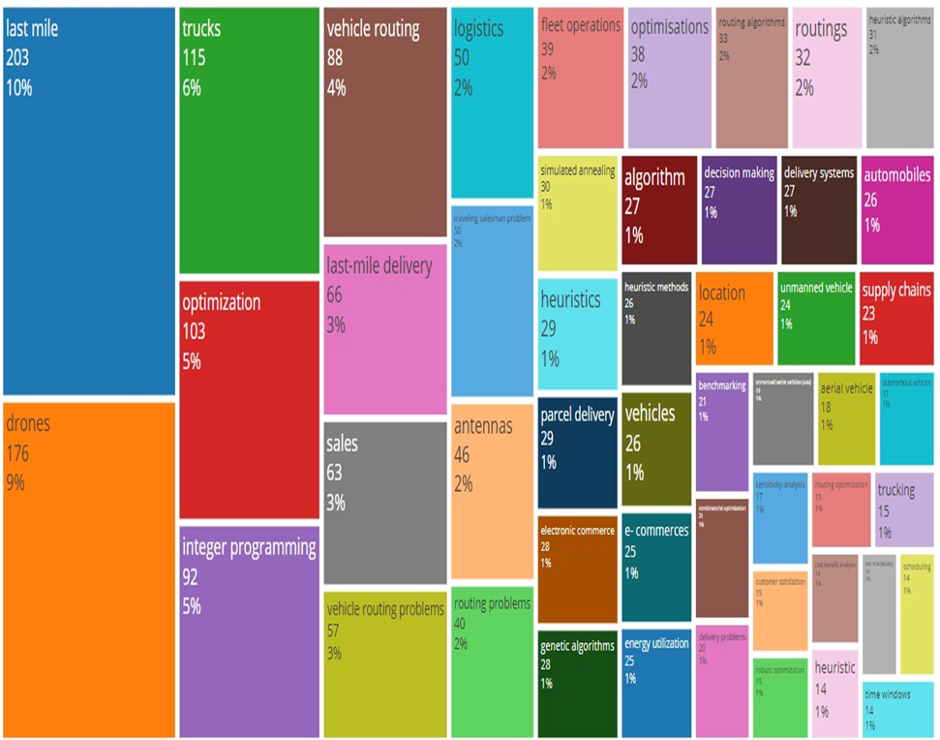
CONTINUED..
Percentage of Research papers found through a Keyword

Slide 13
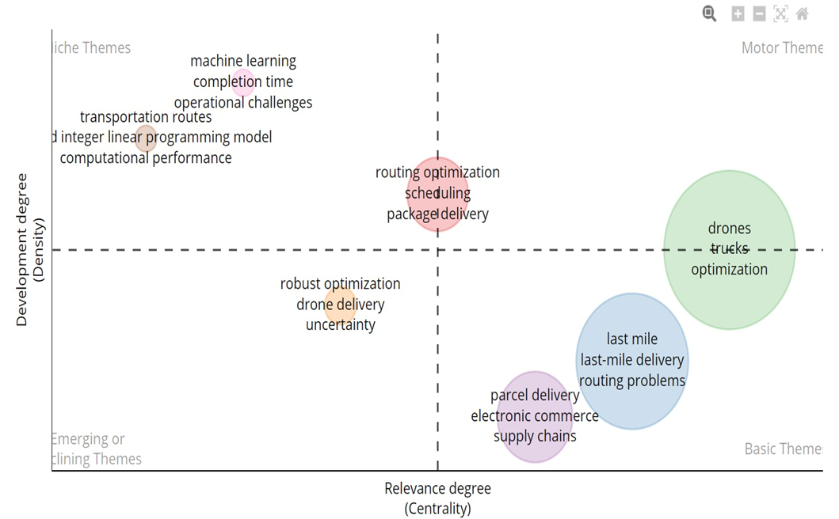
CONTINUED..
Sub-themes of the research domain found by Analysis

Slide 14
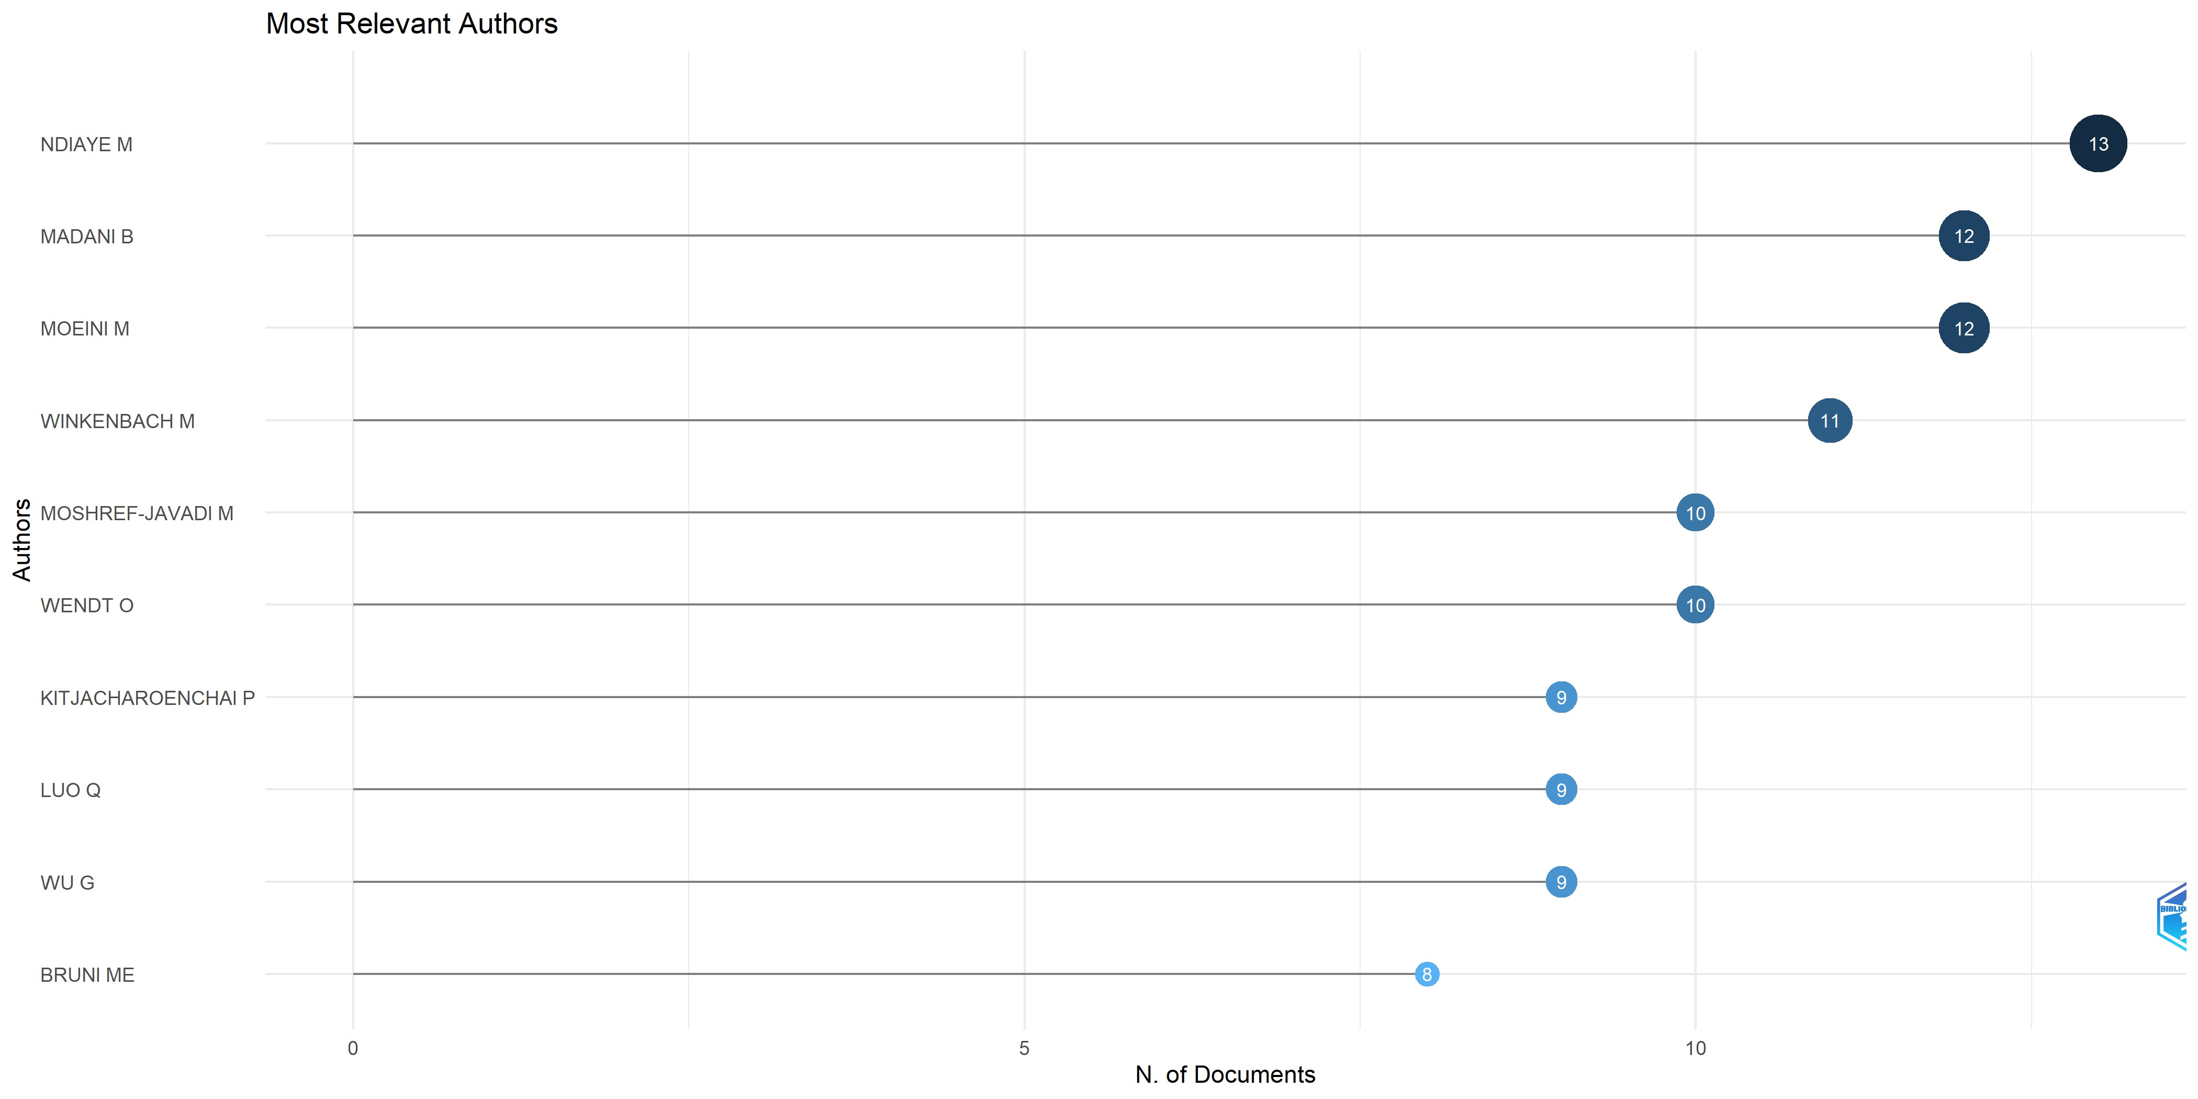
CONTINUED..
Relevant Authors found by Bibliometric Analysis

Slide 15
CONTINUED..
The summary of the literature review is as given below: -
Literature review underscores key contributions and future directions in delivery logistics optimization via truck and drone integration.
Development of efficient algorithms like HTGVNS for larger cases, improving delivery optimization, especially for faster drones.
The main gap in all this model is that they use either only drone or one drone per truck.
Some paper give solution as clustering and routing of drone for better utilisation of truck and drone together.

Slide 16
PROBLEM STATEMENT
This is a delivery logistics problem involving 'N' total delivery points, 'M' of which are exclusive to truck deliveries, with each truck equipped with 'D' drones.
The objective is to partition the 'N' points into clusters, each containing 'D' or fewer points, accommodating both truck and drone deliveries. Designate central focal points within clusters for drone pickup and drop-off.
The primary aim is to determine optimal truck routes passing through designated focal points to optimize drone routes and find the optimum number of drones per truck.
By this we utilize clustering algorithms to group delivery points, optimize truck routes passing through focal points, and analyze drone allocation per truck for efficiency.

Slide 17
VISUALIZING PROBLEM STATEMENT
Depot
Truck only delivery point
Truck/Drone delivery point
The delivery points and the depot of a last mile delivery order

Slide 18
Depot
Truck only delivery point
Truck/ Drone delivery point
Clustering of the delivery point

Slide 19
Depot
Focal point
Drone Delivery point
Choosing focal points

Slide 20
Depot
Focal point
Drone Delivery point
Truck route
Drone route
Truck and drone route

Slide 21
CLUSTERING ALGORITHM
We are implementing K-Means Clustering Algorithm to divide the customer locations into several clusters such that the hybrid truck drone problem can be solved.
K-means is computationally efficient and straightforward to implement, making it well-suited for large logistics datasets.
K-means allows for the specification of the number of clusters, providing flexibility in creating clusters with 'd' or fewer delivery points, aligning with the problem constraints.
K-means provides easily interpretable results with cluster centroids serving as central focal points, making it suitable for designating pickup and drop-off locations for drones within each cluster.
K-means can handle mixed data types, which is useful when dealing with different attributes such as geographical coordinates and drone flight ranges.

Slide 22
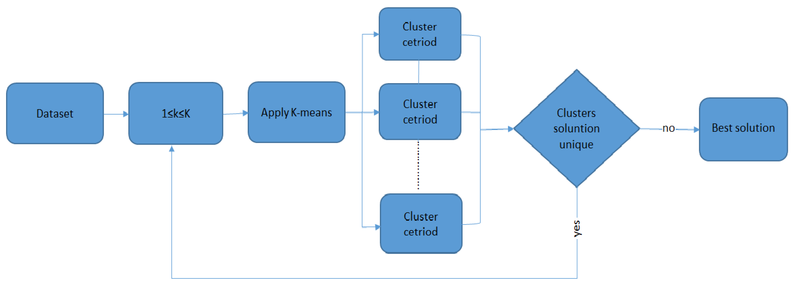
CONTINUED…

Slide 23
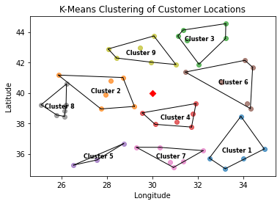
RESULTS OBTAINED
The modified k-means clustering algorithm successfully grouped customer locations, considering constraints on drone flight ranges and a maximum number of drones per cluster.
The visual representation highlights centroids as central points for drone operations, aiding in the selection of optimal pickup and drop-off locations within each cluster.
The algorithm dynamically adjusts the number of clusters to meet constraints, ensuring adherence to specified criteria and accommodating variations in dataset sizes for an optimized logistics solution.
We get the distance matrix of centroids of the clusters as the output.
We also get the distance of each point within the cluster from the centroid of the cluster.

Slide 24
MATHEMATICAL MODELLING
Two mathematical models are being deployed for cost optimization in delivering the packages in last mile delivery.
It is known that 86% of packages shipped by Amazon weigh less than 3 kg (6.5 lb) (Guglielmo, 2013).
Taking that into consideration, 2 models have been formulated with the details of the focus of the model given below.
Mathematical Model 1:
Contains points that can be served by drones.
Focuses on points where packages weigh below 3 kg (86% of all packages).
Mathematical Model 2:
Includes points served by drones and those exclusively served by trucks.
Encompasses all points regardless of package weight, covering both drone- serviced and truck-exclusive areas.

Slide 25
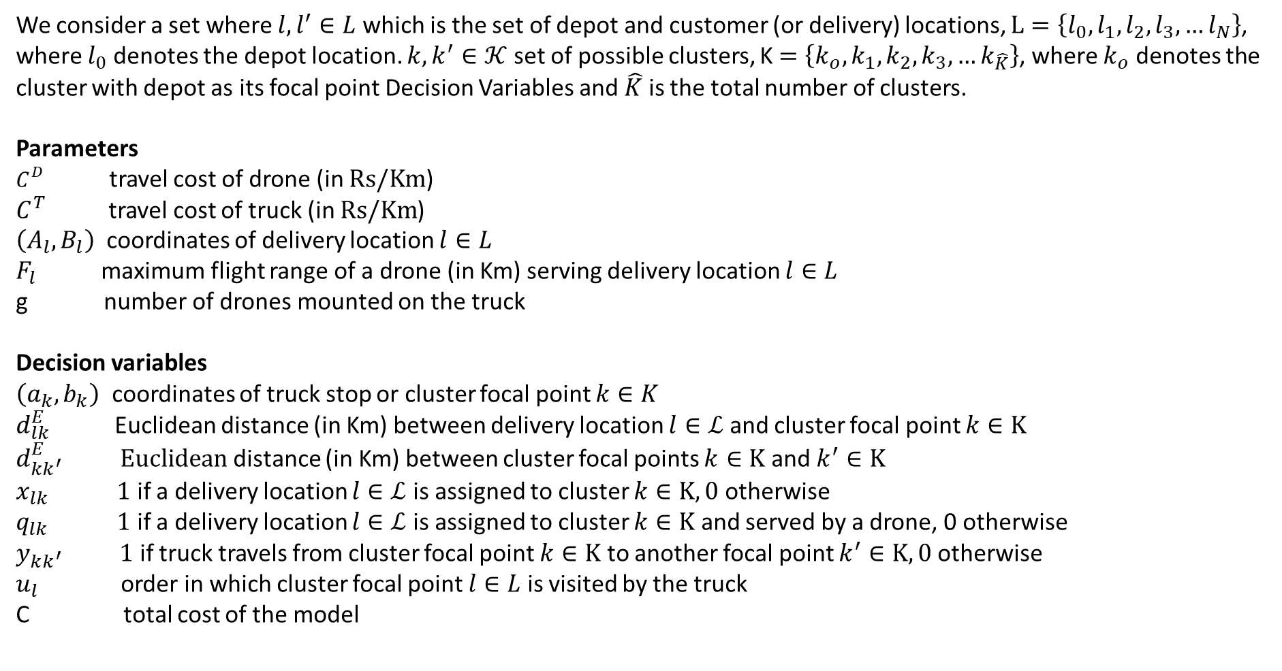
MATHEMATICAL MODEL-1
We consider a set where $l,l^{′}∈L$ which is the set of depot and customer (or delivery) locations, $L=\left\{l_{0},l_{1},l_{2},l_{3},…l_{N}\right\}$, where $l_{0}$ denotes the depot location. $k,k^{′}∈𝒦$ set of possible clusters, K $=\left\{k_{o},k_{1},k_{2},k_{3},…k_{\hat{K}}\right\}$, where $k_{o}$ denotes the cluster with depot as its focal point Decision Variables and $\hat{K}$ is the total number of clusters.
Parameters $C^{D}$ travel cost of drone (in $Rs/Km$) $C^{T}$ travel cost of truck (in $Rs/Km$)
$\left(A_{l},B_{l}\right)$ coordinates of delivery location $l∈L$ $F_{l}$ maximum flight range of a drone (in Km) serving delivery location $l∈L$ g number of drones mounted on the truck
Decision variables $\left(a_{k},b_{k}\right)$ coordinates of truck stop or cluster focal point $k∈K$
$d_{lk}^{E}$ Euclidean distance (in Km) between delivery location $l∈ℒ$ and cluster focal point $k∈K$ $d_{kk^{′}}^{E} Euclidean$ distance (in Km) between cluster focal points $k∈K$ and $k^{′}∈K$ $x_{lk} 1$ if a delivery location $l∈ℒ$ is assigned to cluster $k∈K,0$ otherwise $q_{lk} 1$ if a delivery location $l∈ℒ$ is assigned to cluster $k∈K$ and served by a drone, 0 otherwise $y_{kk^{′}} 1$ if truck travels from cluster focal point $k∈K$ to another focal point $k^{′}∈K,0$ otherwise $u_{l}$ order in which cluster focal point $l∈L$ is visited by the truck C total cost of the model

Slide 26
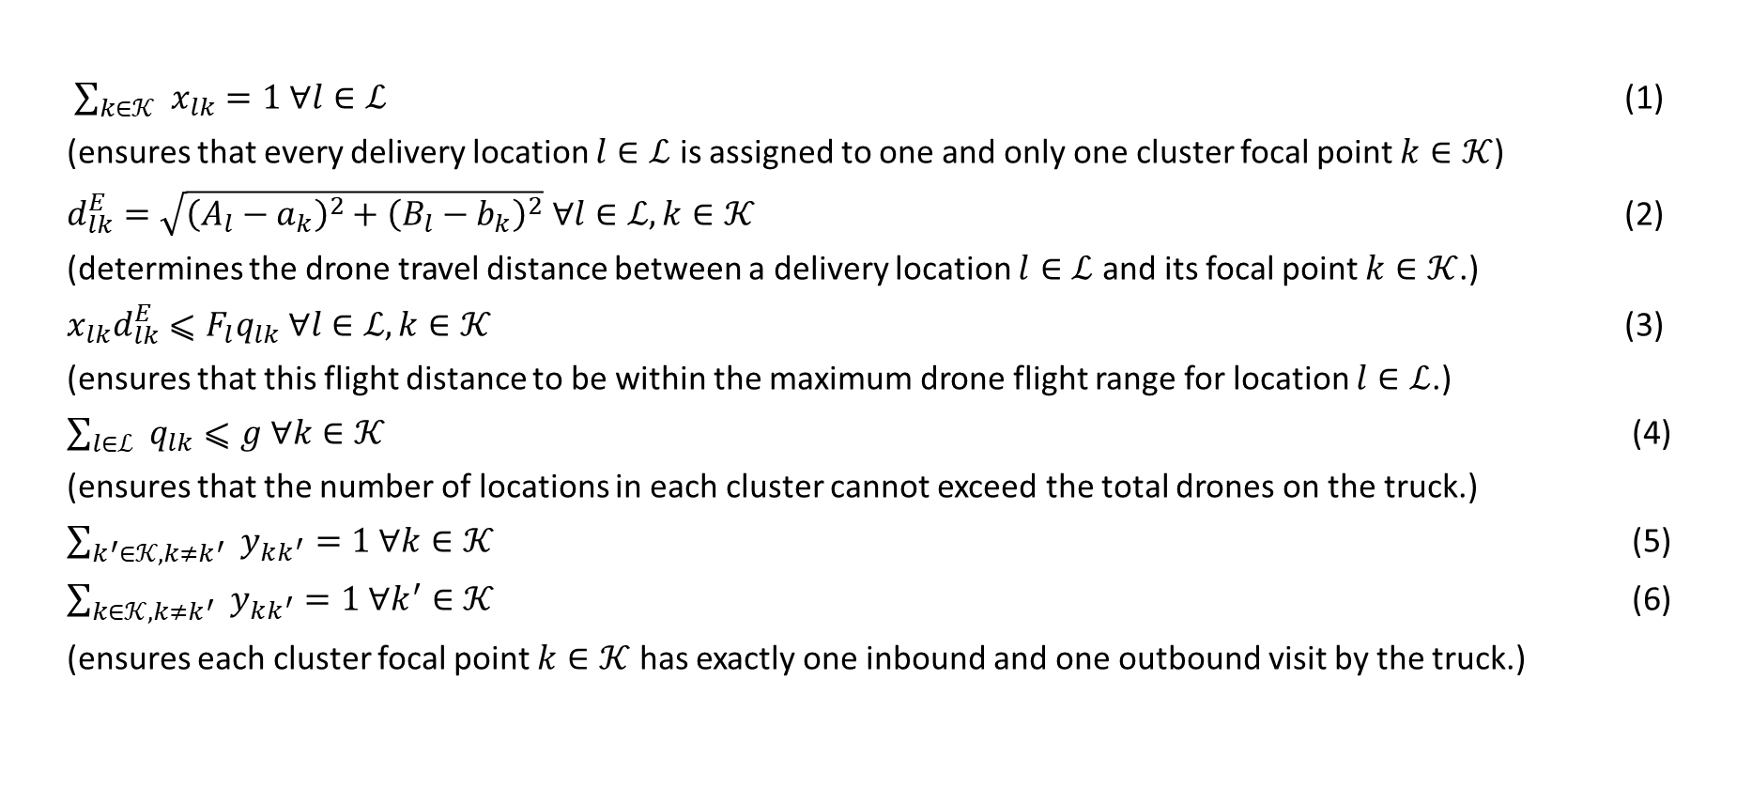
CONTINUED..
Below are the objective function and the constraints for the Hybrid Truck-drone model 1.
Minimize C $={C^{D}∑}_{l∈ℒ} ∑_{k∈𝒦} x_{lk}×\left(2d_{lk}^{E}\right)+C^{T}∑_{k∈𝒦} ∑_{k^{′}∈𝒦} y_{kk^{′}}d_{kk^{′}}^{E}$
$\sum_{k∈𝒦}{ } x_{lk}=1 ∀l∈ℒ$ (1)
(ensures that every delivery location $l∈ℒ$ is assigned to one and only one cluster focal point $k∈𝒦$)
$d_{lk}^{E}=\sqrt{{\left(A_{l}−a_{k}\right)}^{2}+{\left(B_{l}−b_{k}\right)}^{2}} ∀l∈ℒ,k∈𝒦$ (2)
(determines the drone travel distance between a delivery location $l∈ℒ$ and its focal point $k∈𝒦$.)
$x_{lk}d_{lk}^{E}⩽F_{l}q_{lk} ∀l∈ℒ,k∈𝒦$ (3)
(ensures that this flight distance to be within the maximum drone flight range for location $l∈ℒ$.)
$\sum_{l∈ℒ}{ } q_{lk}⩽g ∀k∈𝒦$ (4)
(ensures that the number of locations in each cluster cannot exceed the total drones on the truck.)
$\sum_{k^{′}∈𝒦,k≠k^{′}}{ } y_{kk^{′}}=1 ∀k∈𝒦$ (5)
$\sum_{k∈𝒦,k≠k^{′}}{ } y_{kk^{′}}=1 ∀k^{′}∈𝒦$ (6)
(ensures each cluster focal point $k∈𝒦$ has exactly one inbound and one outbound visit by the truck.)

Slide 27
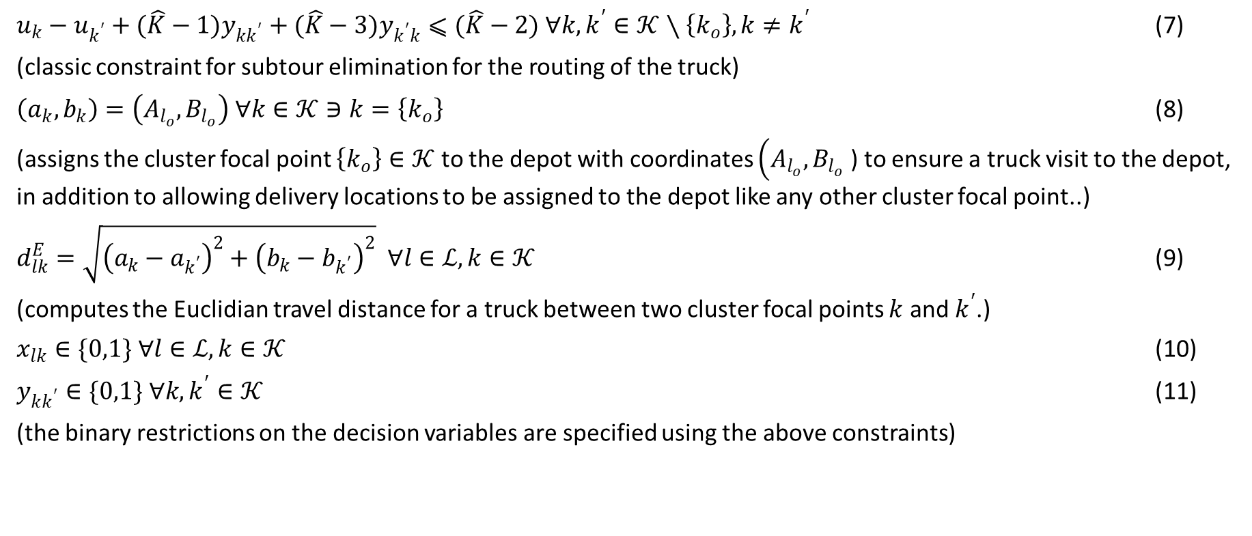
CONTINUED..
$u_{k}−u_{k^{′}}+(\hat{K}−1)y_{kk^{′}}+(\hat{K}−3)y_{k^{′}k}⩽(\hat{K}−2) ∀k,k^{′}∈𝒦∖\left\{k_{o}\right\},k≠k^{′}$ (7)
(classic constraint for subtour elimination for the routing of the truck)
$\left(a_{k},b_{k}\right)=\left(A_{l_{o}},B_{l_{o}}\right) ∀k∈𝒦∋k=\left\{k_{o}\right\}$ (8)
(assigns the cluster focal point $\left\{k_{o}\right\}∈𝒦$ to the depot with coordinates $\left(A_{l_{o}},B_{l_{o}}\right.$ ) to ensure a truck visit to the depot, in addition to allowing delivery locations to be assigned to the depot like any other cluster focal point..)
$d_{lk}^{E}=\sqrt{{\left(a_{k}−a_{k^{′}}\right)}^{2}+{\left(b_{k}−b_{k^{′}}\right)}^{2}} ∀l∈ℒ,k∈𝒦$ (9)
(computes the Euclidian travel distance for a truck between two cluster focal points $k$ and $k^{′}$.)
$x_{lk}∈\{0,1\} ∀l∈ℒ,k∈𝒦$ (10)
$y_{kk^{′}}∈\{0,1\} ∀k,k^{′}∈𝒦$ (11)
(the binary restrictions on the decision variables are specified using the above constraints)

Slide 28
CONTINUED..
In this model we have taken N delivery points and used our clustering algorithm to divide the points in K number of cluster.
We have assumed that there are only drone delivery points and no truck only delivery point for our this model.
The number of cluster are governed by the number of drones we are going to use. ( its upper limit is fixed due to space constrained in truck).
After the clustering we find the centroid of each cluster and pass the truck trough the centroid and use this centroid as focal point from where drone do the delivery.
So, overall we have divided the problem in two stage: -
Clustering of points.
Routing of truck through centroid.

Slide 29
CONTINUED..
Depot
Focal point/Centroid
Drone delivery point
Truck route
Drone route
Clusters

Slide 30
TRAVELLING SALESMAN PROBLEM
The Traveling Salesman Problem (TSP) is a classic optimization problem in computer science and mathematics.
TSP is a problem where a salesman is given a set of cities and must find the shortest possible route that visits each city exactly once and returns to the original city.
Objective of the TSP is to minimize the total distance or cost traveled by the salesman.
he salesman must visit each city exactly once.
The salesman's route must form a closed loop, returning to the starting city.
TSP is known to be NP-hard, meaning there is no known algorithm that solves all instances of the problem in polynomial time unless P equals NP (an open question in computer science).
The goal is not just to find any valid route but to find the route with the minimum total distance.
In our problem we have found the centroids of the clusters through which we route our truck and we modelled our problem as a travelling salesman problem.
Using the centroids of the clusters and a hub, we devise a travelling salesman problem.
We solve the travelling salesman problem to find the route of minimal distance using the excel solver.

Slide 31
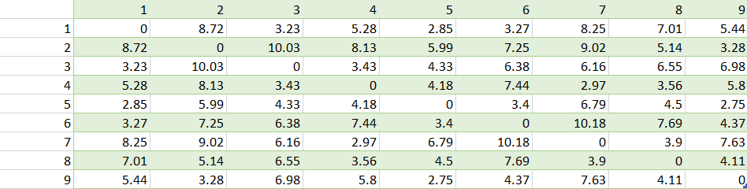
1 | 30.92415 | 35.4645 | 1.913067
1 | 28.04614 | 35.97672 | 1.201039
1 | 30.4671 | 36.84854 | 1.378185
1 | 28.88677 | 37.71349 | 1.448825
1 | 28.58466 | 36.15869 | 0.634159
1 | 28.30898 | 35.63558 | 1.113604
2 | 25.58084 | 43.66176 | 0.521504
2 | 25.20584 | 44.6991 | 0.582974
2 | 25.65052 | 44.48886 | 0.394892
2 | 25.34389 | 44.0932 | 0.109878
2 | 25.74551 | 44.86887 | 0.774815
2 | 25.05522 | 43.15461 | 1.074073
3 | 33.32443 | 37.12339 | 0.972491
3 | 31.11853 | 36.39494 | 1.360289
3 | 31.07545 | 36.70524 | 1.315651
3 | 33.28738 | 38.56753 | 1.884215
3 | 32.72245 | 36.98716 | 0.355403
3 | 32.7127 | 35.74045 | 1.227153
4 | 32.31994 | 40.98658 | 0.708372
4 | 31.84233 | 39.40152 | 1.210746
4 | 32.29606 | 41.37557 | 1.082084
4 | 33.87213 | 39.72215 | 1.40679
4 | 32.60785 | 40.61277 | 0.273345
4 | 32.70967 | 39.93796 | 0.414146
5 | 28.04242 | 40.24756 | 1.293271
5 | 29.31945 | 37.91229 | 1.369896
5 | 27.92145 | 38.66362 | 0.821891
5 | 28.11711 | 40.20068 | 1.218707
5 | 28.10982 | 38.25183 | 0.984373
5 | 30.22733 | 39.27541 | 1.614859
6 | 26.56019 | 36.55995 | 0.680392
6 | 26.81825 | 36.83405 | 0.830715
6 | 25.88493 | 36.95983 | 0.111362
6 | 25.45227 | 38.2533 | 1.423214
6 | 25.25419 | 36.07891 | 1.133107
Centroid distance matrix
Distance from cluster centroid

Slide 32
RESULTS OBTAINED
We obtained the following results using 50 random locations in an area of 100 km sq using excel solver.
In truck-only model we calculated the results by delivering the packages using truck alone by simulating it as a TSP.
We then compared the results by calculating the results using the hybrid truck-drone model which we shall call as Hybrid Model 1.
In this model we used the clustering algorithm to form several clusters of the 50 delivery points.
Then we find the centroids of each cluster through which the truck will traverse.
The truck shall stop at each centroid location and the drones shall complete the delivery of the packages to that particular cluster.
We have solved the truck routing through the centroids of the clusters as a TSP.

Slide 33
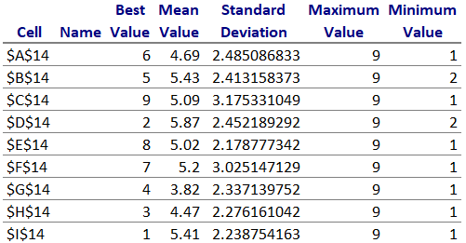
CONTINUED..
We have taken the costs incurred per km for a truck as Rs 50 and for a drone as Rs 6
Below is the route taken by the truck through the centroid of the 9 clusters from cluster 6 to cluster 1 at the end.
The costs incurred using Truck-only model is found to be Rs 2992.5
The costs incurred using Hybrid Model-1 is found to be the sum of Rs 1568.5 for the truck and Rs 641.2 which is 2209.7.
There is a profit of Rs 782.8 by using Hybrid Model-1 over Truck-only Model.

Slide 34
CONTINUED..
To see the effect of change in number of drones in the cost of delivery in our model to a normal truck delivery we did few simulation using 25 delivery points.
We varied the number of drones from 4-8 while keeping other things same.
The result we got is shown in the table below: -
Numbers of delivery point | Numbers of drones | Cost of using only truck | Cost of hybrid model | Change in cost | % change in cost
25 | 4 | 2046 | 1712 | 334 | 16.32%
25 | 5 | 2046 | 1711 | 335 | 16.37%
25 | 6 | 2046 | 1689 | 357 | 17.45%
25 | 7 | 2046 | 1637 | 409 | 19.99%
25 | 8 | 2046 | 1665 | 381 | 18.62%

Slide 35
DATA COLLECTION
We will employ NIT Calicut as the central model for our drone routing investigation.
Concentrating our analysis on 30 strategically chosen delivery points situated within the expansive main campus.
Designating the Campus main gate as the pivotal dispatch point, marking the starting hub for drone operations.
Initiating our comprehensive analysis and routing exploration from this central and strategically chosen dispatch location.
The 30 points we have chosen strategically are the entrances of Administration Block, New Lecture hall complex, Main Building, A-Hostel, D- Hostel, Centre for Career development, Department building, School of Material Science and engineering, Department of Architecture and Electrical engineering PG block ,etc.
We have obtained the distance matrix for the above points considering the main gate as the hub.

Slide 36
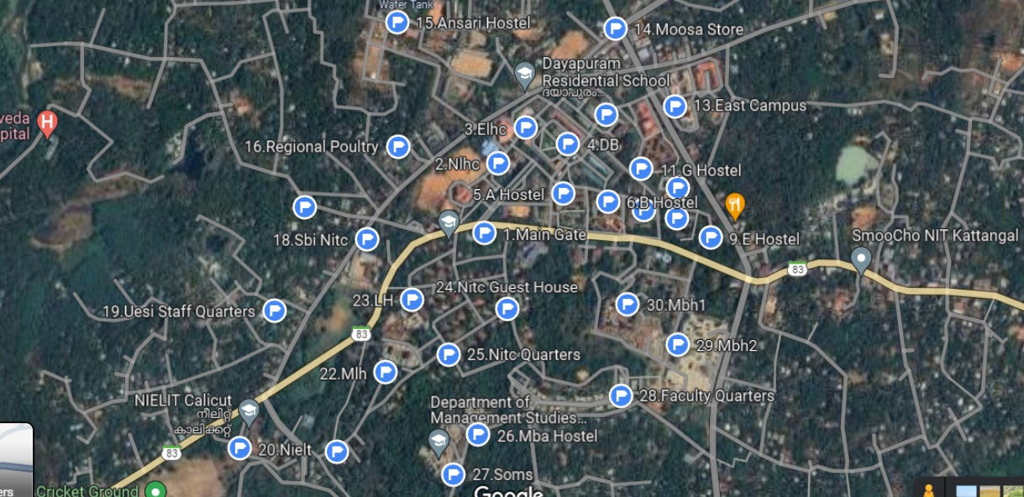

Slide 37
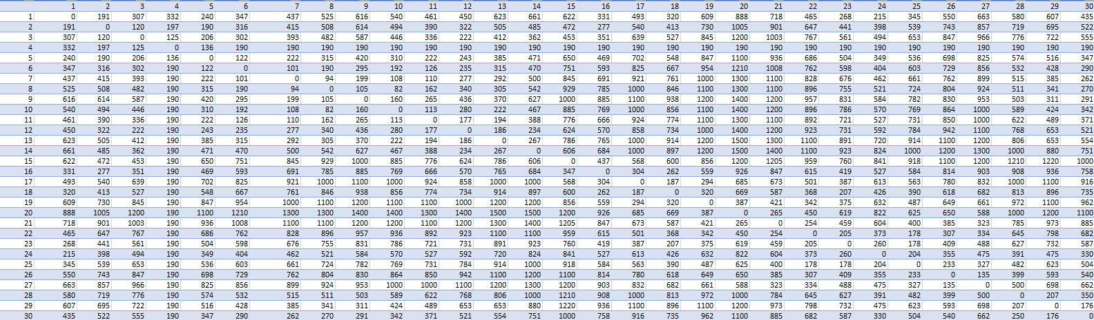
DISTANCE MATRIX

Slide 38
NITC SIMULATION USING HYBRID MODEL 1
Thirty locations on the NITC campus and nearby areas are selected for testing the hybrid model.
The Bing Maps API is utilized to obtain the distance matrix of these locations.
Out of the 30 points, 23 are randomly chosen by the model, and clusters are generated from all the points.
A distance matrix of all the points is generated, considering driving distance.
The program generates files containing centroids of the clusters, distance matrix of centroid and distance between centroid and delivery point.
The Bing Maps API finds the nearest point to the centroid if centroid don’t lie on road, determining the route for the truck.
The problem is transformed into a simple Travelling Salesman Problem (TSP) and solved using Excel Solver.
The simulation is repeated eight times to assess the impact of different clusters based on the chosen points.

Slide 39
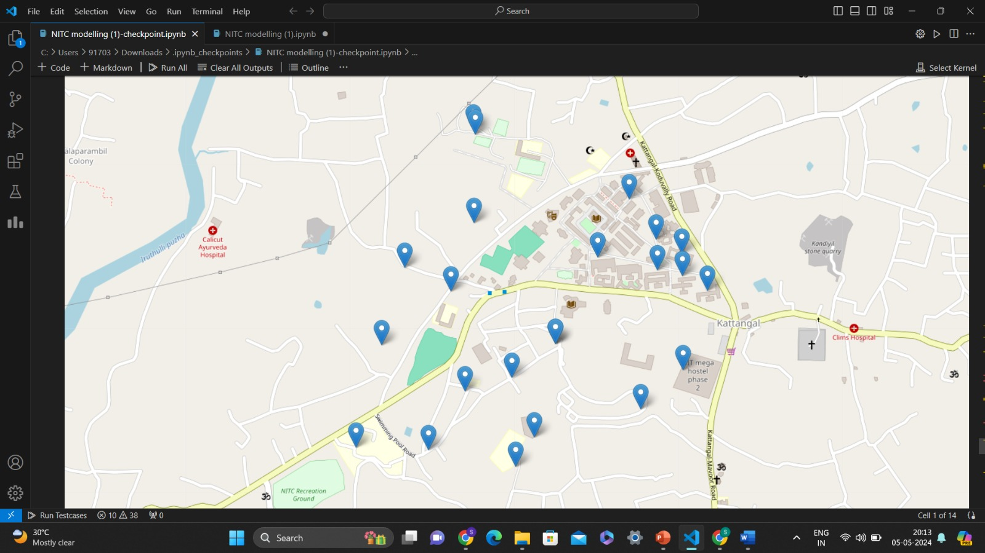
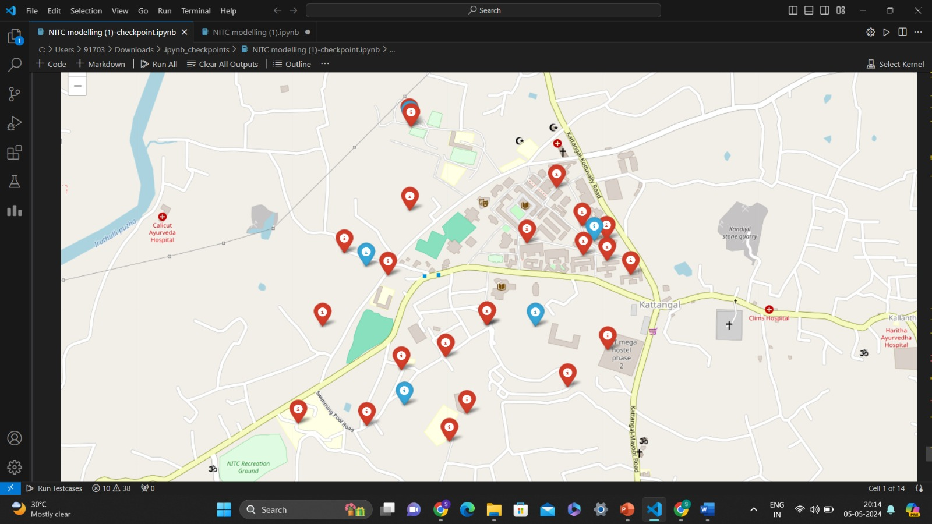
CONTINUED..
Points before clustering
Points after clustering
(blue points are centroid of the cluster)

Slide 40
SIMULATION RESULTS
After performing 8 simulation by selecting 23 random points from 30 point selected following table and graph is obtained: -
Number of iterations | Cost with truck only | Cost with hybrid model 1 | Percentage change
1 | 534.65 | 279.3 | 47.76021696
2 | 451.8 | 302.5 | 33.0455954
3 | 453.55 | 338.5 | 25.36655275
4 | 461.8 | 251.75 | 45.48505847
5 | 450 | 239.4 | 46.8
6 | 442.75 | 255 | 42.40542067
7 | 440.1 | 265.5 | 39.67280164
8 | 469.55 | 265.5 | 43.45650091
It can be observed that the average cost incurred by using the truck only model for NITC Campus is found to be Rs 463.025 whereas the same by using the Hybrid model 1 for NITC campus is found to be Rs 274.68125.
Hence the Rs 188.37 and the savings obtained by implementing the hybrid model 1 is found to be 40.5 % of the truck only model for NITC campus simulation.

Slide 41
CONTINUED..
As clear from the table and graph below that there is good amount of cost cutting in using hybrid model than normal truck routing
The change in cost can be easily visualised by the comparison graph given below.

Slide 42
CONTINUED..
To see the effect of change of number of drone on the simulation, we varied the number of drones used keeping the points same in the simulation. The numbers are varied from 4-8 and the result are as shown below: -
Number of delivery points | Number of drones | Truck-only Model cost | Hybrid Model cost | Percentage change
23 | 4 | 363.85 | 294.3 | 19.11501993
23 | 5 | 363.85 | 255.5 | 29.77875498
23 | 6 | 363.85 | 259.8 | 28.59694929
23 | 7 | 363.85 | 279.2 | 23.26508176
23 | 8 | 363.85 | 186 | 48.88003298

Slide 43
CONTINUED..
From the above graph it can be observed that it has a local maxima while using 5 drones and the slope of the graph increases after using 8 drones
This can be explained as while using 5 drones we have maxima due to it being an optimum while using 8 drones the delivery is done mostly only by drone so it being maxima serves no purpose at it make our truck obsolete in model.
This shows that there is an optimum number of drones which can be deployed to obtain the best possible results.

Slide 44
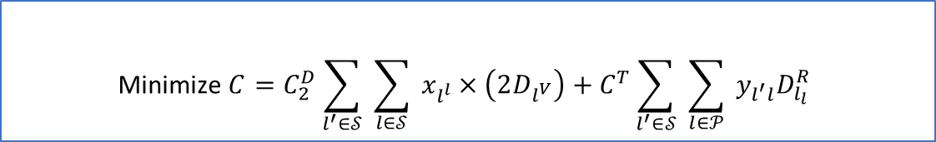
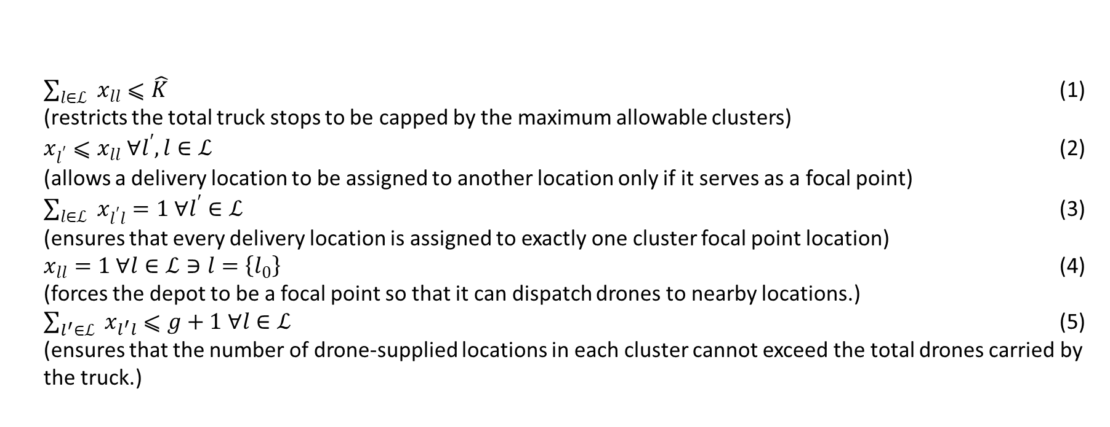
MATHEMATICAL MODEL-2
Below are the objective function and the constraints for the Hybrid Truck-drone model 2.
$$\text{Minimize} C=C_{2}^{D}\sum_{l^{′}∈𝒮}{ }\sum_{l∈𝒮}{ }x_{l^{l}}×\left(2D_{l^{V}}\right)+C^{T}\sum_{l^{′}∈𝒮}{ }\sum_{l∈𝒫}{ }y_{l^{′}l}D_{l_{l}}^{R}$$
$\sum_{l∈ℒ}{ } x_{ll}⩽\hat{K}$ (1)
(restricts the total truck stops to be capped by the maximum allowable clusters)
$x_{l^{′}}⩽x_{ll} ∀l^{′},l∈ℒ$ (2)
(allows a delivery location to be assigned to another location only if it serves as a focal point)
$\sum_{l∈ℒ}{ } x_{l^{′}l}=1 ∀l^{′}∈ℒ$ (3)
(ensures that every delivery location is assigned to exactly one cluster focal point location)
$x_{ll}=1 ∀l∈ℒ∋l=\left\{l_{0}\right\}$ (4)
(forces the depot to be a focal point so that it can dispatch drones to nearby locations.)
$\sum_{l^{′}∈ℒ}{ } x_{l^{′}l}⩽g+1 ∀l∈ℒ$ (5)
(ensures that the number of drone-supplied locations in each cluster cannot exceed the total drones carried by the truck.)

Slide 45
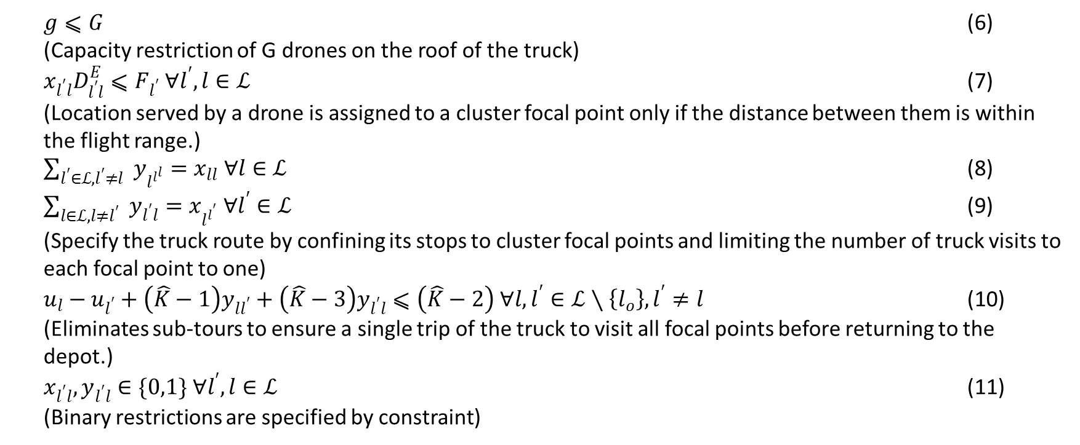
CONTINUED..
$g⩽G$ (6) (Capacity restriction of G drones on the roof of the truck)
$x_{l^{′}l}D_{l^{′}l}^{E}⩽F_{l^{′}} ∀l^{′},l∈ℒ$ (7)
(Location served by a drone is assigned to a cluster focal point only if the distance between them is within the flight range.)
$\sum_{l^{′}∈ℒ,l^{′}≠l}{ } y_{l^{l^{l}}}=x_{ll} ∀l∈ℒ$ (8)
$\sum_{l∈ℒ,l≠l^{′}}{ } y_{l^{′}l}=x_{l^{l^{′}}} ∀l^{′}∈ℒ$ (9)
(Specify the truck route by confining its stops to cluster focal points and limiting the number of truck visits to each focal point to one)
$u_{l}−u_{l^{′}}+\left(\hat{K}−1\right)y_{ll^{′}}+\left(\hat{K}−3\right)y_{l^{′}l}⩽\left(\hat{K}−2\right) ∀l,l^{′}∈ℒ∖\left\{l_{o}\right\},l^{′}≠l$ (10)
(Eliminates sub-tours to ensure a single trip of the truck to visit all focal points before returning to the depot.)
$x_{l^{′}l},y_{l^{′}l}∈\{0,1\} ∀l^{′},l∈ℒ$ (11)
(Binary restrictions are specified by constraint)

Slide 46
CONTINUED..
In this model we have taken N delivery points and used our clustering algorithm to divide the points in K number of cluster.
In this model, we include the points which can only be delivered by the truck alone because of the weight constraints and also the points which can be served by both.
The division of points to be served by truck or drone will be decided by the weight of the package.
The number of cluster are governed by the number of drones we are going to use. ( its upper limit is fixed due to space constrained in truck).
After the clustering we find the focal point of each cluster and pass the truck trough the focal point as the truck needs to serve the focal points in this case.
So, overall we have divided the problem in two stage: -
Clustering of points
Routing of truck through the focal points

Slide 47
RESULTS OBTAINED
Comparative analysis is conducted between Hybrid Model-2 and the truck only model, utilizing 20 to 30 random locations in a 10 km sq. area via Excel solver.
In truck-only model, a truck alone was employed, treating it as a TSP to deliver packages and in Hybrid Model 2, a hybrid truck-drone approach was adopted.
Here, a clustering algorithm is used to group the delivery points into clusters and determined the focal points for each cluster.
The truck traversed through these focal points, stopping at each, while drones completed package deliveries within the cluster.
Costs were set at Rs 50 per km for the truck and Rs 6 for drones.

Slide 48
CONTINUED..
From the below table and graph, it is observed that for a truck-only model, the average cost obtained Rs 624, whereas for Hybrid Model-2, it amounted to Rs 509.
Consequently, Hybrid Model-2 yielded an average profit of Rs 115 which is a savings of 18.5 %.
Number of Points | Cost with truck only | Cost with hybrid model | Percentage change
20 | 516.7 | 405.4 | 21.5
23 | 622 | 458.21 | 26.3
25 | 631.292 | 579.5 | 8.2
27 | 679.8 | 553.86 | 18.5
30 | 671.48 | 550.3 | 18.04

Slide 49
CONCLUSIONS
The study overall provides a better algorithm for hybrid truck-drone delivery model by clustering and routing the drone.
The hybrid models help in providing solution for low range and payload capacity of drone which hinder its use in last mile delivery.
The hybrid model also is optimises total cost.
The total saving in hybrid model 1 is nearly 20% taking Euclidean distance while using NITC simulation we save nearly 40%
The total saving in hybrid model 2 is nearly18.5%.

Slide 50
CONCLUSIONS
The hybrid model 2 also shows that even large and heavy packages can be delivered using this algorithm.
The study also shows there is optimum number of drone (7 per truck for 25 points 5 per truck for 23 points) , which should be use for better utilisation of resources.
Using truck to only pass through few points not only save cost but even save energy as well.
Also the NITC Campus simulation shows that in real world the cost optimisation will be higher than in our Euclidian distance method due to the road driving distance always being higher than Euclidian distance.

Slide 51
FUTURE SCOPE
Future scope in this study can be done in following area: -
Dynamic Cluster Adaption: - The cluster can be made more dynamic in nature by connecting it to real time traffic situation or whether conditions.
Urban delivery challenges: - Address the unique challenges of urban delivery environments, including congested traffic, limited airspace for drones, and restricted access to delivery locations
Collaborative Delivery Networks: -Explore the potential for collaboration among multiple delivery providers and stakeholders to optimize delivery routes and share resources more efficiently.
Integration of emerging technology: - Investigate the integration of emerging technologies such as artificial intelligence (AI) and Internet of Things (IoT) devices to enhance route planning and monitoring capabilities

Slide 52
THANK YOU

